Slide 1

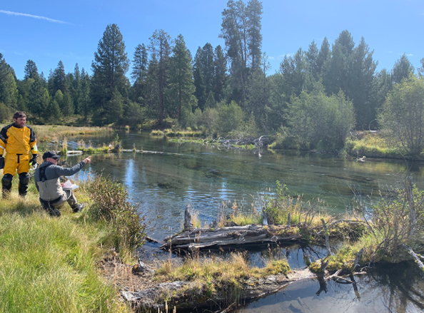
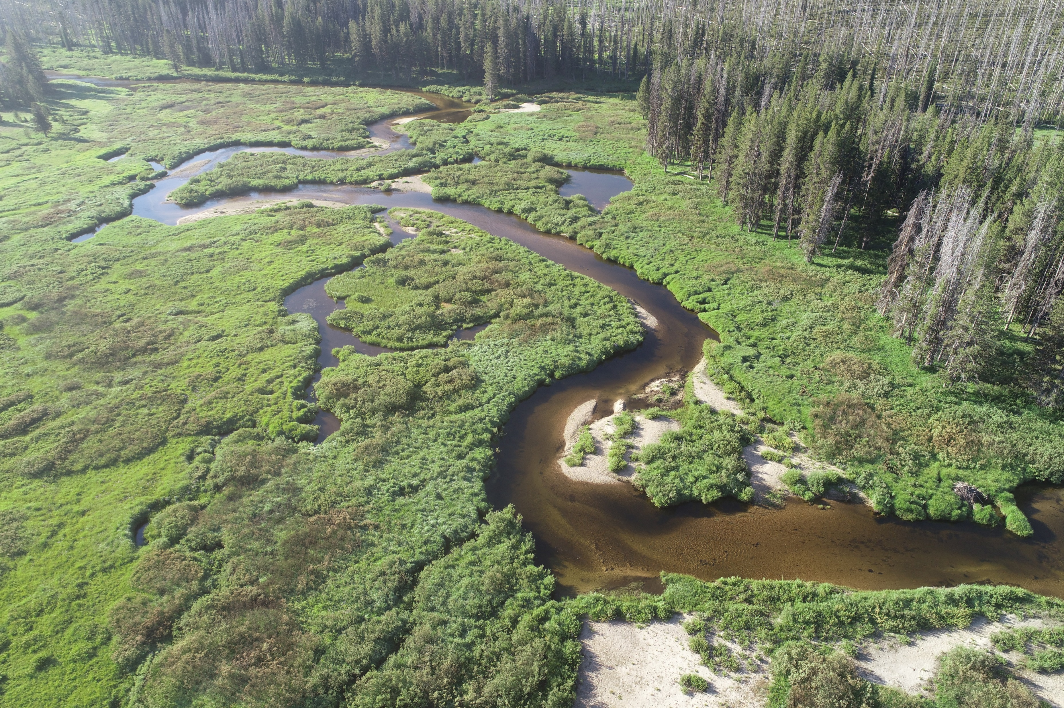
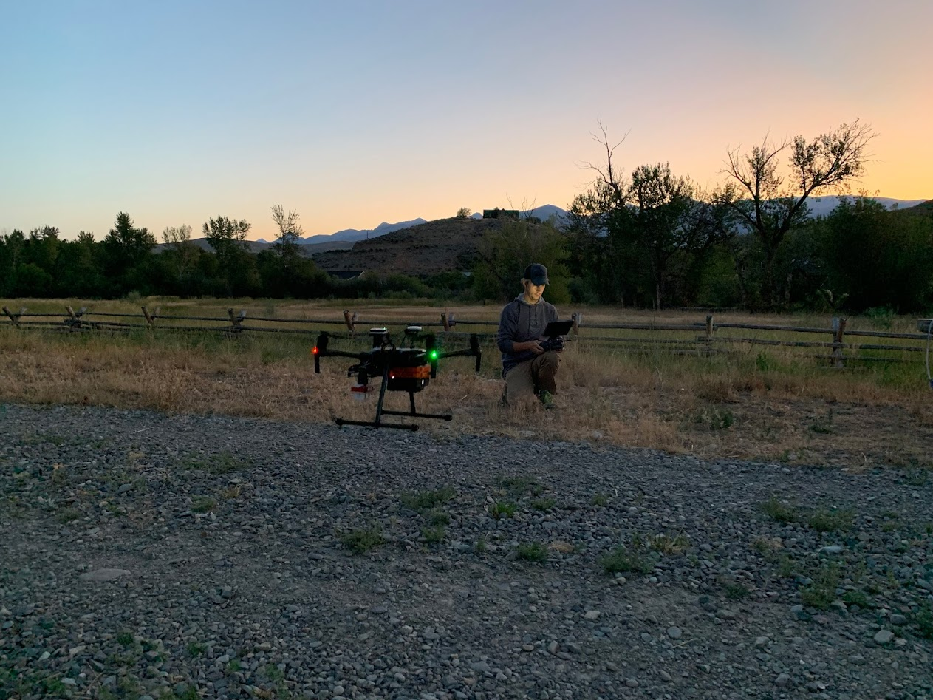
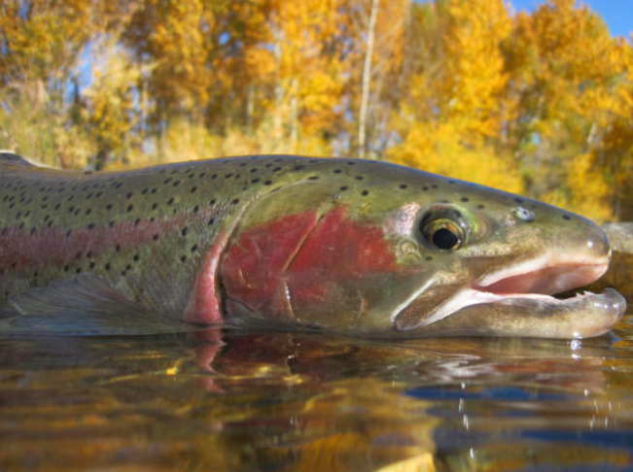
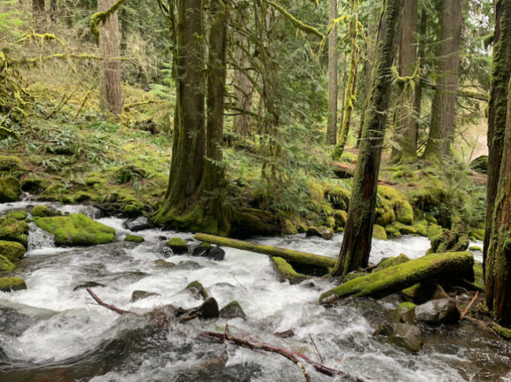
Drone Assisted Stream Habitat (DASH) Surveys: What high-quality habitat can teach us about habitat rehabilitation
Tulley Mackey¹, Bryce Oldemeyer¹, Mark Roes¹, Mike Ackerman¹, Richie Carmichael², Tim Hanrahan³, and Sam Box³
National American Fisheries Society - August 2022
1. Mount Hood Environmental, 2. Biomark, Inc., 3. Rio Applied Science and Engineering
Notes:
Hi, my name is Tulley Mackey. I live in Salmon, ID where I’ve been involved in fish conservation work for over a decade. I work for Mt Hood Environmental as a field biologist and I’m a graduate student at the University of Idaho in the water resources program.
Today, I’ll be presenting on the use of Drone Assisted Stream Habitat surveys in central Idaho to evaluate fish capacity of both high quality habitat in relatively pristine watersheds and impacted habitat in degraded watersheds. By identifying habitat characteristics associated with high capacity, we hope this comparative analysis will help resource managers and rehabilitation planners prioritize areas for rehabilitation and inform rehabilitation design. I’d like to thank my colleagues, Bryce Oldemeyer, Marc Roes and Mike Ackerman at Mt Hood Environmental, Richie Carmichael at Biomark, and Tim Hanrahan and Sam Box at Rio ASE for helping me put this presentation together.

Slide 2
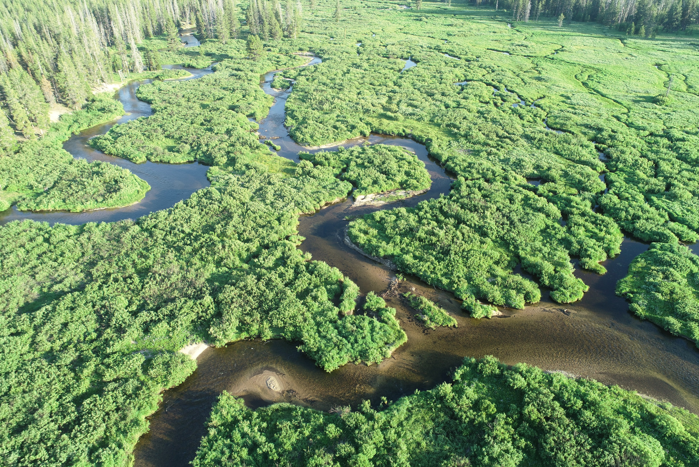




Notes:
I’d also like to thank our other project collaborators and funders: Idaho Governor’s Office of Species Conservation, Idaho Department of Fish and Game, and US Bureau of Reclamation.

Slide 3
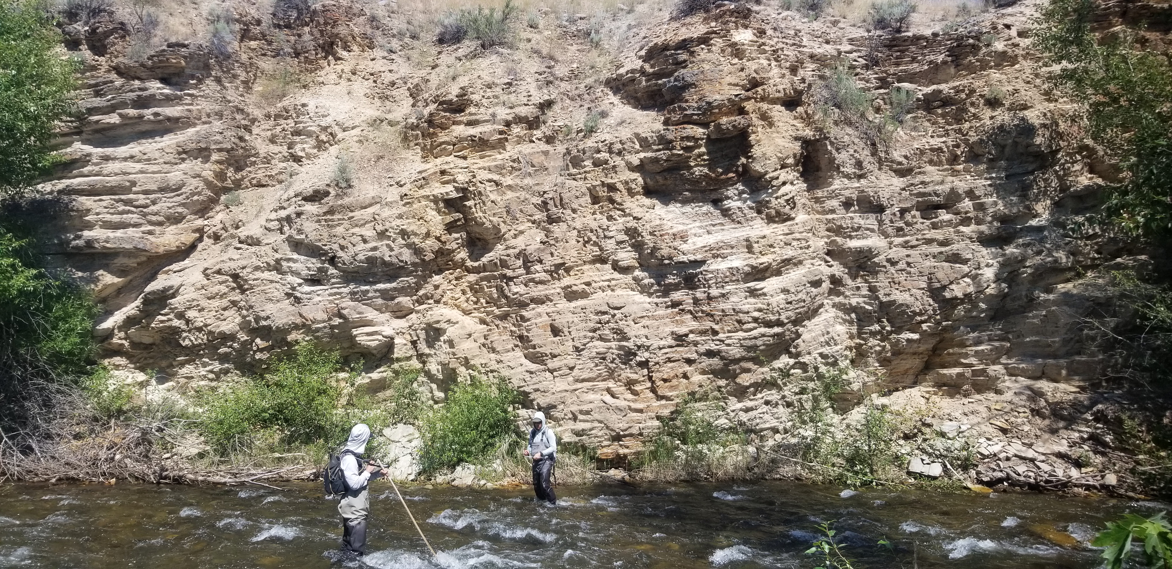
Presentation outline
Motivation, goals and objectives
Methods
Locations
Results: Chinook winter rearing
Summary
Questions
Notes:
In this presentation, I’ll be covering the motivation behind the habitat surveys and what we hope to gain from them, our survey and analysis methodology, and the locations we surveyed. I’ll share results from our analysis at the watershed and reach scales using Chinook winter rearing as a case study. To finish, I’ll give a quick presentation summary and highlight what resource managers and rehabilitation planners might take away from our assessment.

Slide 4
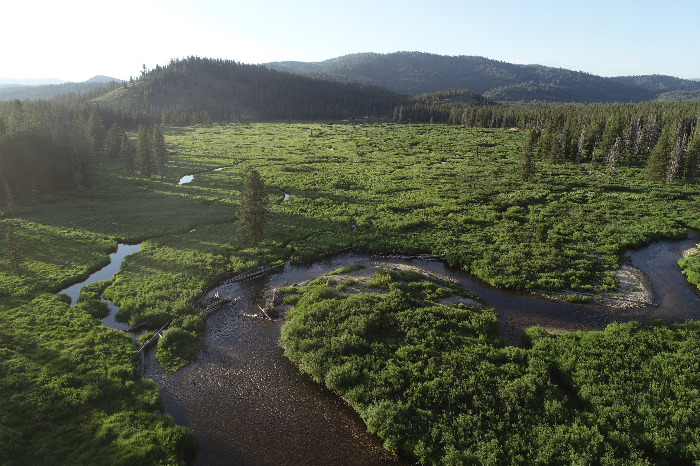
Motivation, goals and objectives
High quality habitat characteristics underrepresented in relic datasets (ISEMP-CHaMP)
High quality habitat vs degraded habitat:
Watershed comparisons across the basin
Identify target conditions to inform habitat rehabilitation
Establish habitat characteristic benchmarks
Notes:
What’s the motivation behind the habitat assessment? Working with relic fish-habitat datasets, the Integrated Status and Effectiveness Monitoring Program and the Columbia Habitat Monitoring Program (ISEMP-CHaMP), two long-term studies that employed a spatially random sampling design, we felt that high-quality habitat was underrepresented. We wanted to explore this further, wondering what capacity estimates and habitat characteristics look like for relatively pristine reaches and watersheds and how they compare to areas of degraded habitat. We hypothesize that areas of high quality habitat will have higher capacity estimates which can help inform habitat rehabilitation efforts by identifying target conditions and habitat characteristic benchmarks.

Slide 5
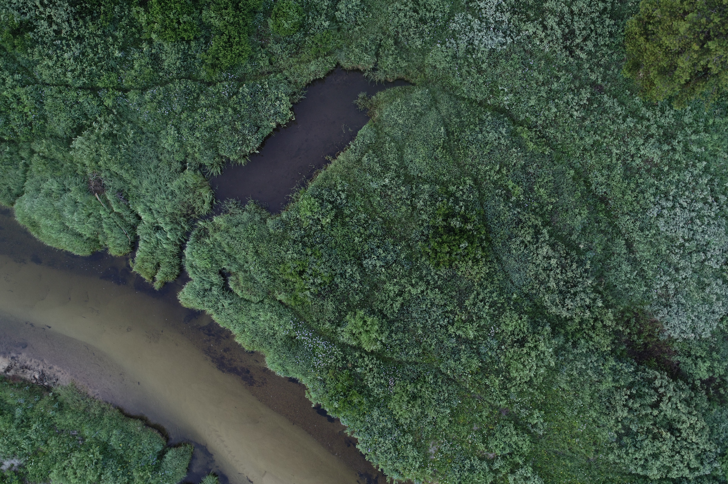
Methods
Identified reference reaches
Surveyed 27 kilometers using Drone Assisted Stream Habitat protocol (DASH; Carmichael et al. 2019)
Estimated capacity at reach scale- Quantile Random Forest Model
(QRF; See et al. 2021)
Estimated watershed capacity- Random Forest Extrapolation Model (See et al. 2021)
Compared estimates and habitat characteristics to impacted reaches and watersheds
Capacity estimates by species (Chinook salmon and steelhead) and life stage (redds, summer, winter)
Carmichael, R. A., M. W. Ackerman, K. See, B. Lott, T. Mackay, and C. Beasley. 2019. Drone Assisted Stream Habitat (DASH) Protocol, DRAFT. Biomark, Applied Biological Services.
See, K.E., M.W. Ackerman, R.A. Carmichael, S.L. Hoffman, C. Beasley. 2021. Estimating carrying capacity for juvenile salmon using a quantile forest model. Ecosphere 12(3):e03404. 10.1002/ecs2.3404
Notes:
To conduct the assessment, we first identified “reference reaches”, what we considered high-quality habitat, using land-use histories, spatial data and professional judgement. Next, we surveyed 27 kilometers across 12 sites in three watersheds using the Drone Assisted Stream Habitat protocol, known as DASH. We plugged our DASH data into a Quantile Random Forest model to make capacity estimates at the reach scale. Then, we rolled up capacity estimates to the watershed scale using a Random Forest Extrapolation model. Comparisons were then made to reaches and watersheds in our DASH dataset that have significant anthropogenic impacts. Capacity estimates were made by species and life stage, which may help elucidate potential population bottlenecks. I’m not going to explain the reach and watershed modeling any further in my presentation but my colleague, Bryce Oldemeyer, will be presenting on both models later this afternoon and I recommend sticking around for his presentation. I’d also like to point-out that at our “reference reach” assessment was not intended to capture the distribution of habitat in those watersheds. Rather, we sought out specific reaches we thought contained high-quality habitat and would have higher capacity estimates. I think it’s important to keep this in mind while I’m discussing our results.

Slide 6
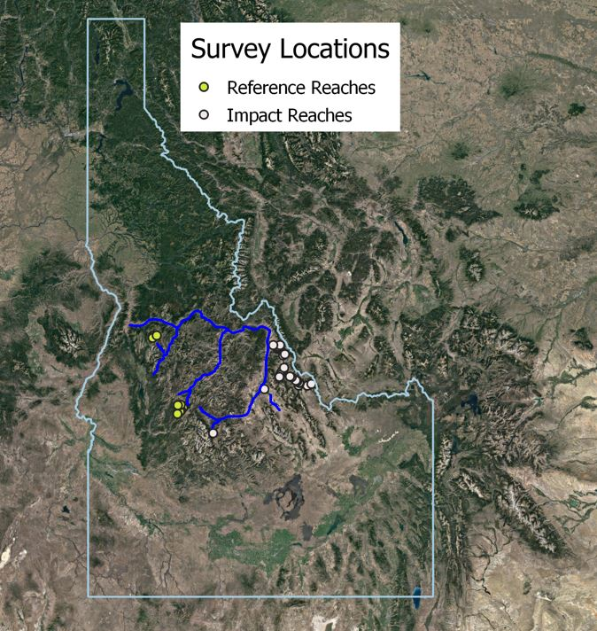
Notes:
Reference reaches were surveyed in the in the Secesh watershed, tributary to the SF Salmon River, and in the Bear Valley and Marsh Cr watersheds, tributaries to the MF Salmon River. The sites surveyed within these watersheds ranged in length of 1.2 km to 4.1 km of contiguous habitat.
Impacted sites that have been surveyed are located in the upper Salmon River, Pahsimeroi River, and the Lemhi River watersheds.

Slide 7
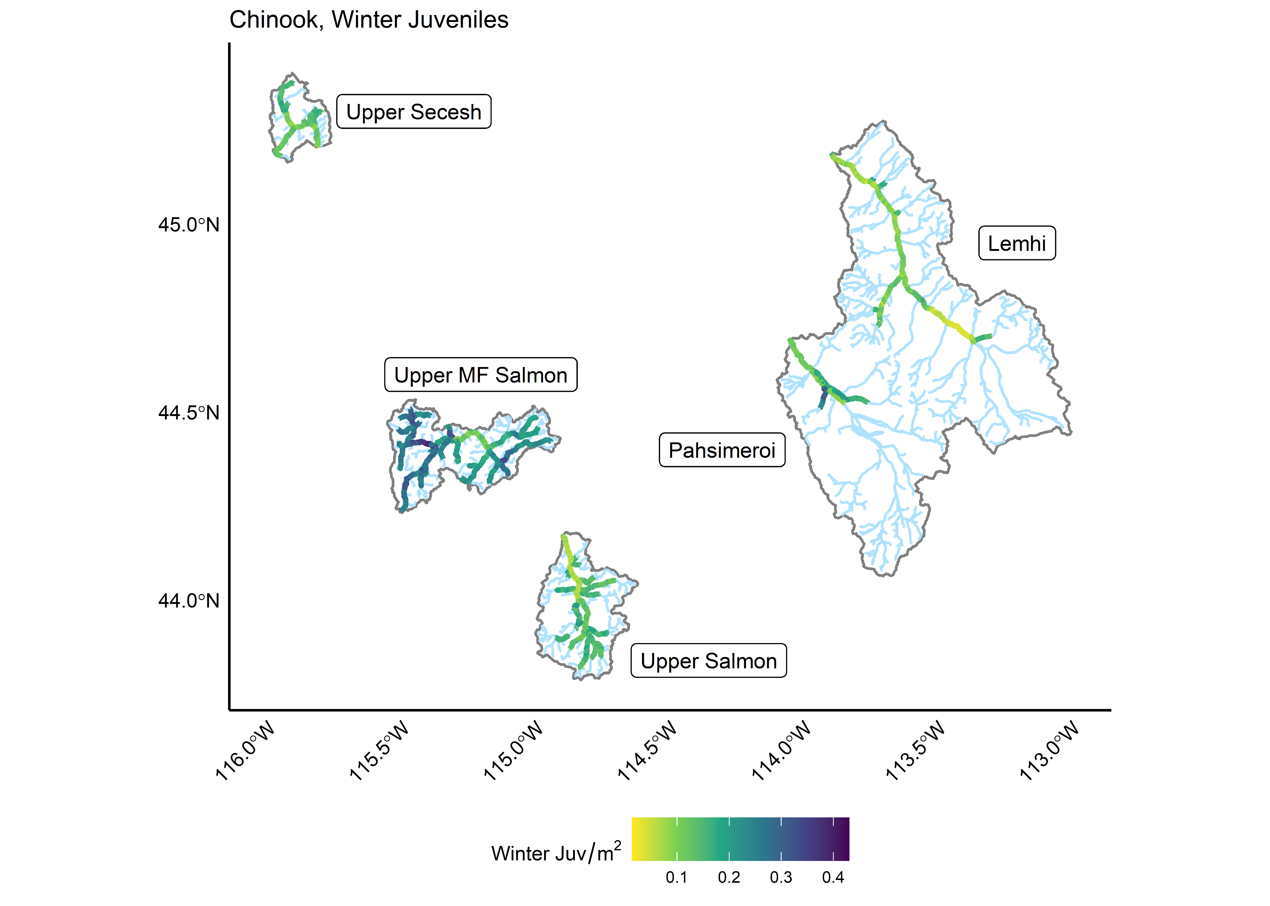
Watershed Results
Notes:
To share results, I’ll be using Chinook winter rearing as a case study from our dataset. Previous work has identified this life stage as a population bottleneck for Chinook salmon in the Lemhi, Pahsimeroi and upper Salmon watersheds. Rehabilitation efforts in the Lemhi and Pahsimeroi have begun addressing this limiting factor through reach prioritization and rehabilitation designs.
This figure depicts capacity estimates at the watershed scale using the Random Forest extrapolation model for Chinook winter rearing. We have latitude on the y-axis and longitude x-axis to geo-reference the watersheds. Capacity (fish/m²) is represented by the color bar at the bottom. The darker the color, the greater the habitat capacity. We used the watershed scale outputs to see if our hypothesis that the MF and Secesh watersheds have greater capacity was correct, and, for the most part, it was. Here we can see that the MF has higher winter capacity than the impacted watersheds. The Secesh doesn’t measure up to the MF for winter rearing but summer rearing and redd capacity are higher than impacted watersheds although not shown here.

Slide 8
Watershed results
Notes:
Using violin plots we can see the distribution of habitat capacity within each watershed for Chinook wintering rearing, again using extrapolation results. The violin plots do a good job of showing that, generally, all watersheds have some level of habitat variability, containing both high and low capacity reaches. Again, we can see that the MF Salmon River is at the upper end of capacity estimates across watersheds.

Slide 9
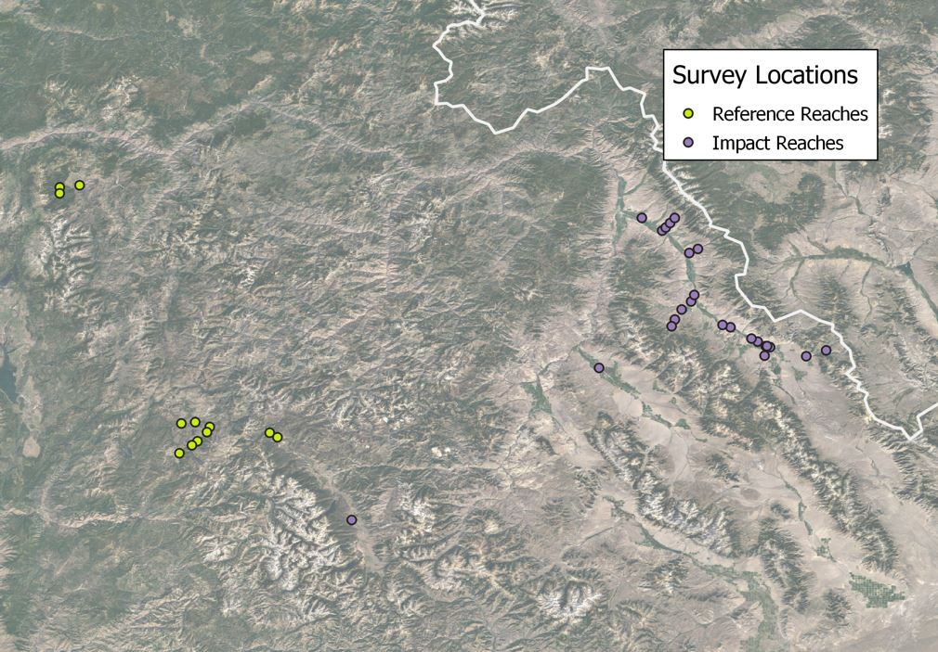
Reach scale results
Notes:
Where the watershed analysis used the Random Forest extrapolation model to estimate capacity, our reach scale analysis leveraged only those reaches we surveyed using DASH, shown here. DASH data was then plugged into the Quantile Random Forest model to compute reach scale estimates. The reach scale is where we hoped to find more compelling data that would support our hypothesis of the reference reaches exhibiting higher capacity estimates than the impacted reaches.

Slide 10
Reach scale results by watershed
Notes:
Looking at the distribution of winter habitat capacity at the reach scale , we see a high level of variability within each watershed as well. This doesn’t fit our hypothesis as well as we hoped but it’s not that surprising either. The reaches we surveyed across all watersheds contained some good and some not so good habitat. In the Lemhi, for example, some sites we sampled had both really poor habitat (think of a 500 m riffle with no cover) and good habitat with multi-threaded channels, lots plenty of wood cover and high channel unit frequency. Noticeably, the Secesh watershed supports a higher capacity for winter rearing comparatively using the only the DASH data.
Because of the high capacity variability at the reach scale, we went back to the drawing board to look at the data differently. To better understand what makes for good habitat and what makes for poor habitat we looked strictly at the top and bottom ten percent of the capacity distribution across all watersheds for Chinook winter rearing and made comparisons.

Slide 11
Habitat metric use by top and bottom 10% of capacity distribution
Notes:
Here we show habitat metrics that have a statistically significant difference between the top and bottom ten percent of the distribution for Chinook winter rearing. Not surprisingly, channel unit frequency, fish cover and substrate are drivers of winter capacity. Channel unit frequency is the number of channel units per 100 m. Channel units consist of riffles, pools, runs, rapids, off-channel areas and small side channels. Channel unit frequency is a good indicator of reach complexity and winter capacity. Interestingly, we see that higher proportions of sands and fines, compared to boulders and cobble, is a predictor for greater capacity. This is contrary to some published literature which document chinook salmon utilizing larger substrate in the winter for concealment. We think in our analysis that sands and fines may be a surrogate for slower water velocities. Water velocity is an important habitat characteristic for winter rearing, directly effecting condition factor and survival. Thalweg exit depth and wetted channel braidedness are also drivers of winter capacity. Wetted channel braidedness is a metric that has captured the attention of regional rehabilitation planners in the last few years. We are currently collaborating with Biomark and Idaho’s Department of Fish and Game monitoring side channel use in restored reaches in the Lemhi River for a more focused study of side channel design.

Slide 12
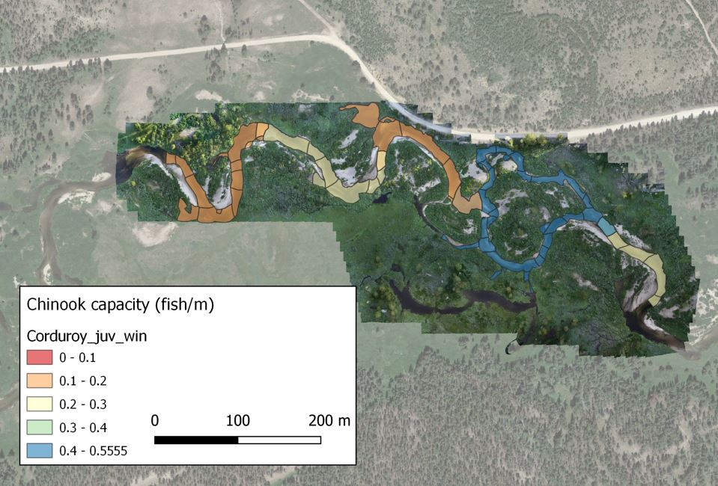
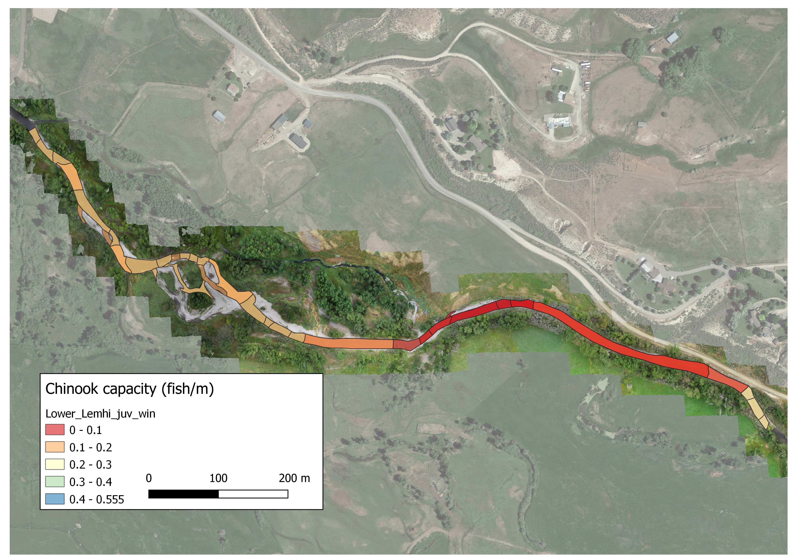
Site Comparison winter capacity
Elk Creek, MF Salmon
Lower Lemhi River
Notes:
We are also able to use our assessment to evaluate and compare specific sites within or across watersheds. Here we have habitat capacity estimates for Chinook winter rearing measured in fish/m for an impacted site on the lower Lemhi River and a reference reach on Elk Cr, tributary to the MF Salmon River. Polygon breaks represent discrete habitat units. In the Lemhi, you’ll notice long, simplified habitat with reaches of lower winter capacity compared to the sinuous, multi-threaded Elk Cr with reaches of higher carrying capacity. Both reaches contain habitat with medium capacity too, further illustrating the nuances and complexity of habitat quality on small scales.

Slide 13
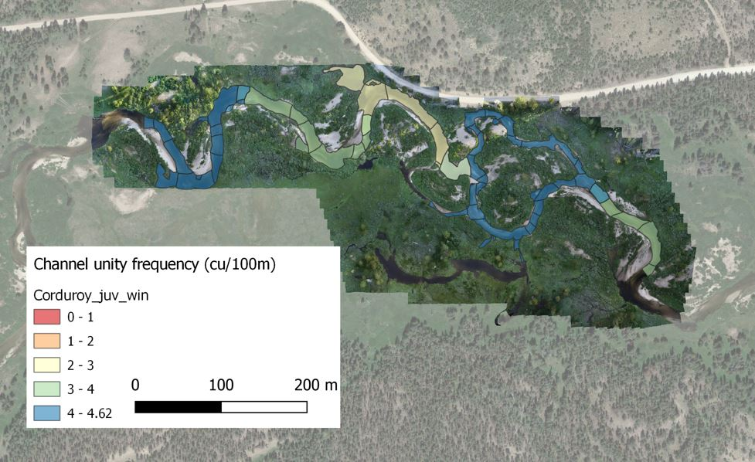
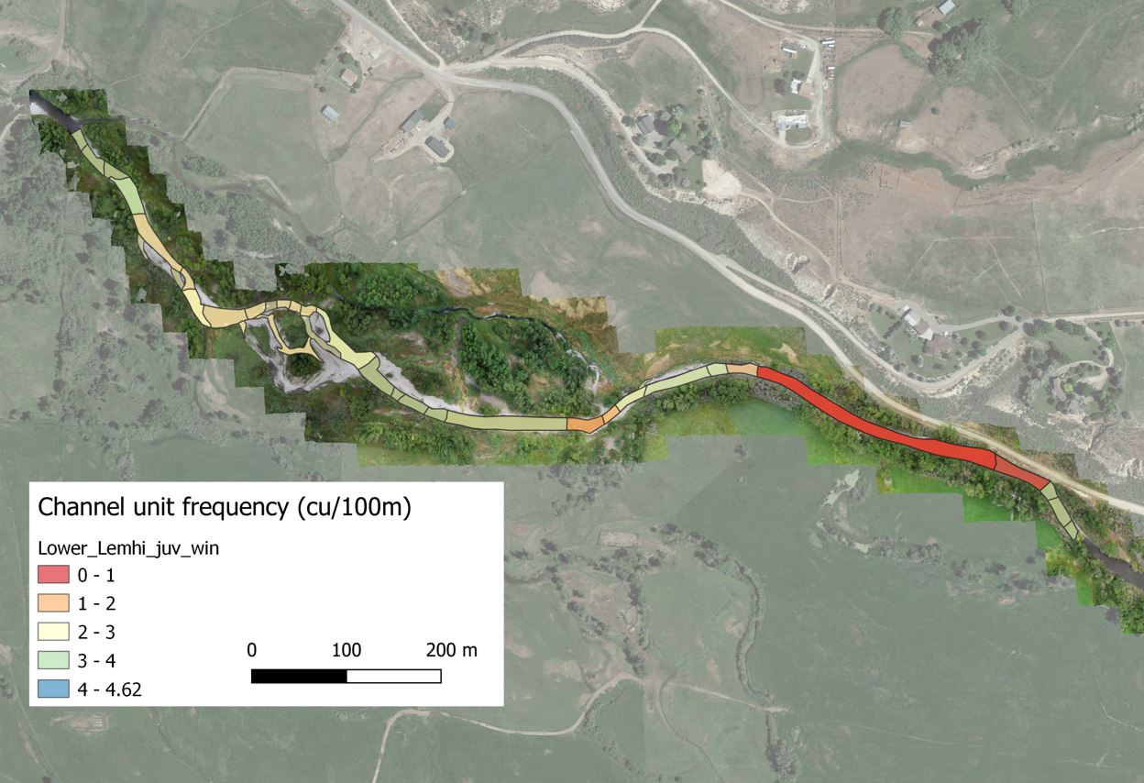
Site Comparison channel unit frequency
Elk Creek, MF Salmon
Lower Lemhi River
Notes:
We can also look at different habitat metrics spatially across sites for comparison. Here we have channel unit frequency (cu/100m) for the two sites. We can see that Elk Cr has greater channel unit frequency then the Lemhi for much of the site. Again, we see a long homogeneous reach in the Lemhi that’s associated with low capacity.

Slide 14
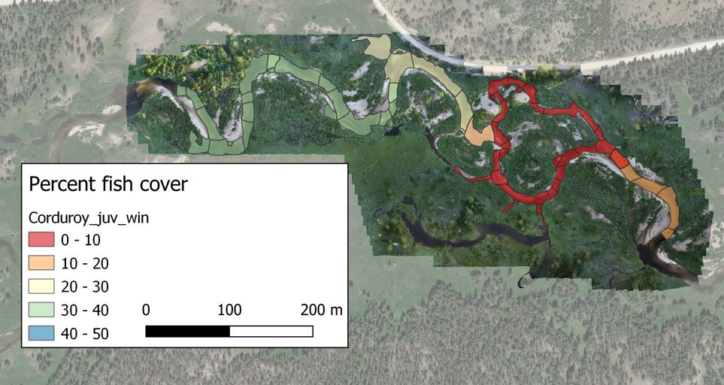
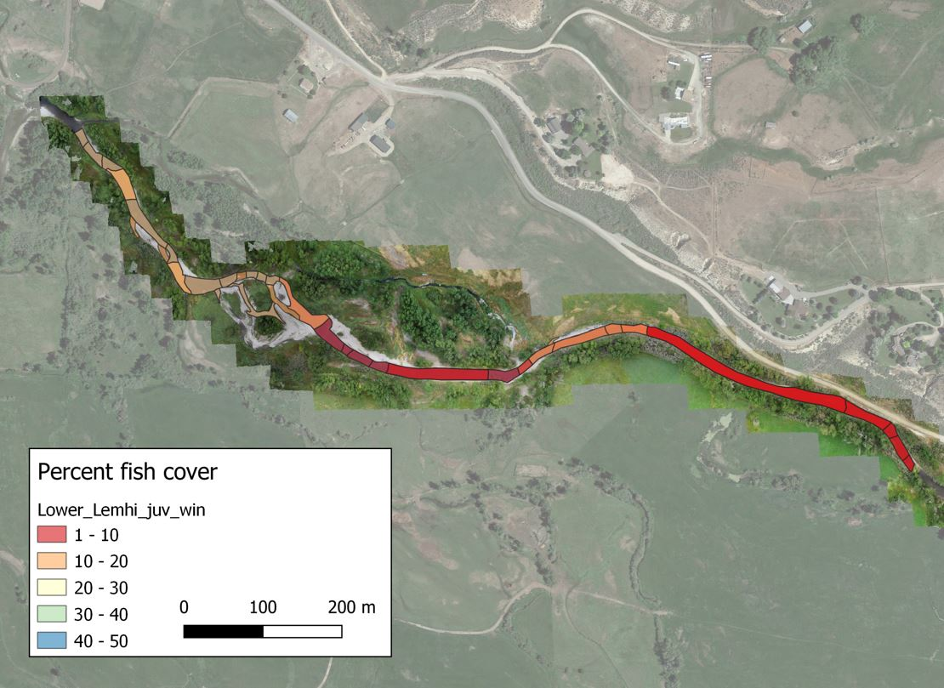
Site Comparison fish cover
Elk Creek, MF Salmon
Lower Lemhi River
Notes:
Looking at percent fish cover, we can see the lower Lemhi site has some habitat with decent cover, but again we see a real deficit in this reach on the right. Much of Elk Cr does not have high percentages of cover, particularly the area of split flow, which had some of the higher capacity estimates for the site. For rehabilitation planners this site level analysis could be really helpful in guiding rehabilitation prioritization and design by identifying reaches with low capacity and habitat attribute deficits.

Slide 15
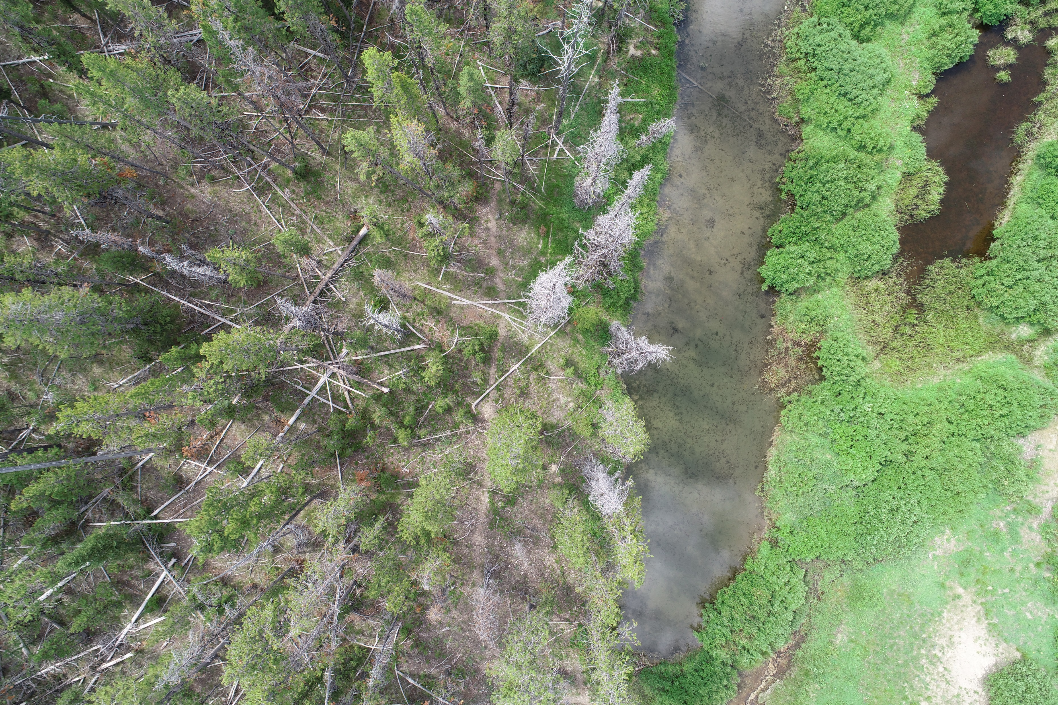
Summary
Watershed Scale
Our hypothesis was mostly validated
Variability in habitat capacity across all watersheds
Reach Scale
High habitat capacity variability across all watersheds
“Cream of the crop” and “bottom of the barrel” approach helped elucidate statistically significant results for certain habitat metrics
Chinook winter rearing:
Channel unit frequency
Cover
Substrate
Thalweg exit depth
Wetted channel braidedness
Notes:
In summary, watershed results using the Random Forest Extrapolation model aligned with our hypothesis that the reference reaches would produce higher capacity estimates. However, these results still exhibited capacity variability across all watersheds. At the reach scale there was high capacity variability, suggesting that reaches in each watershed typically contained a spectrum of habitat quality. This led us to take a different approach, focusing on the top and bottom 10% of the capacity distribution for all watersheds. This approach identified habitat metrics with statistically significant differences between high and low quality habitat. For Chinook winter rearing this includes channel unit frequency, cover, substrate, thalweg exit depth and wetted channel braidedness.

Slide 16
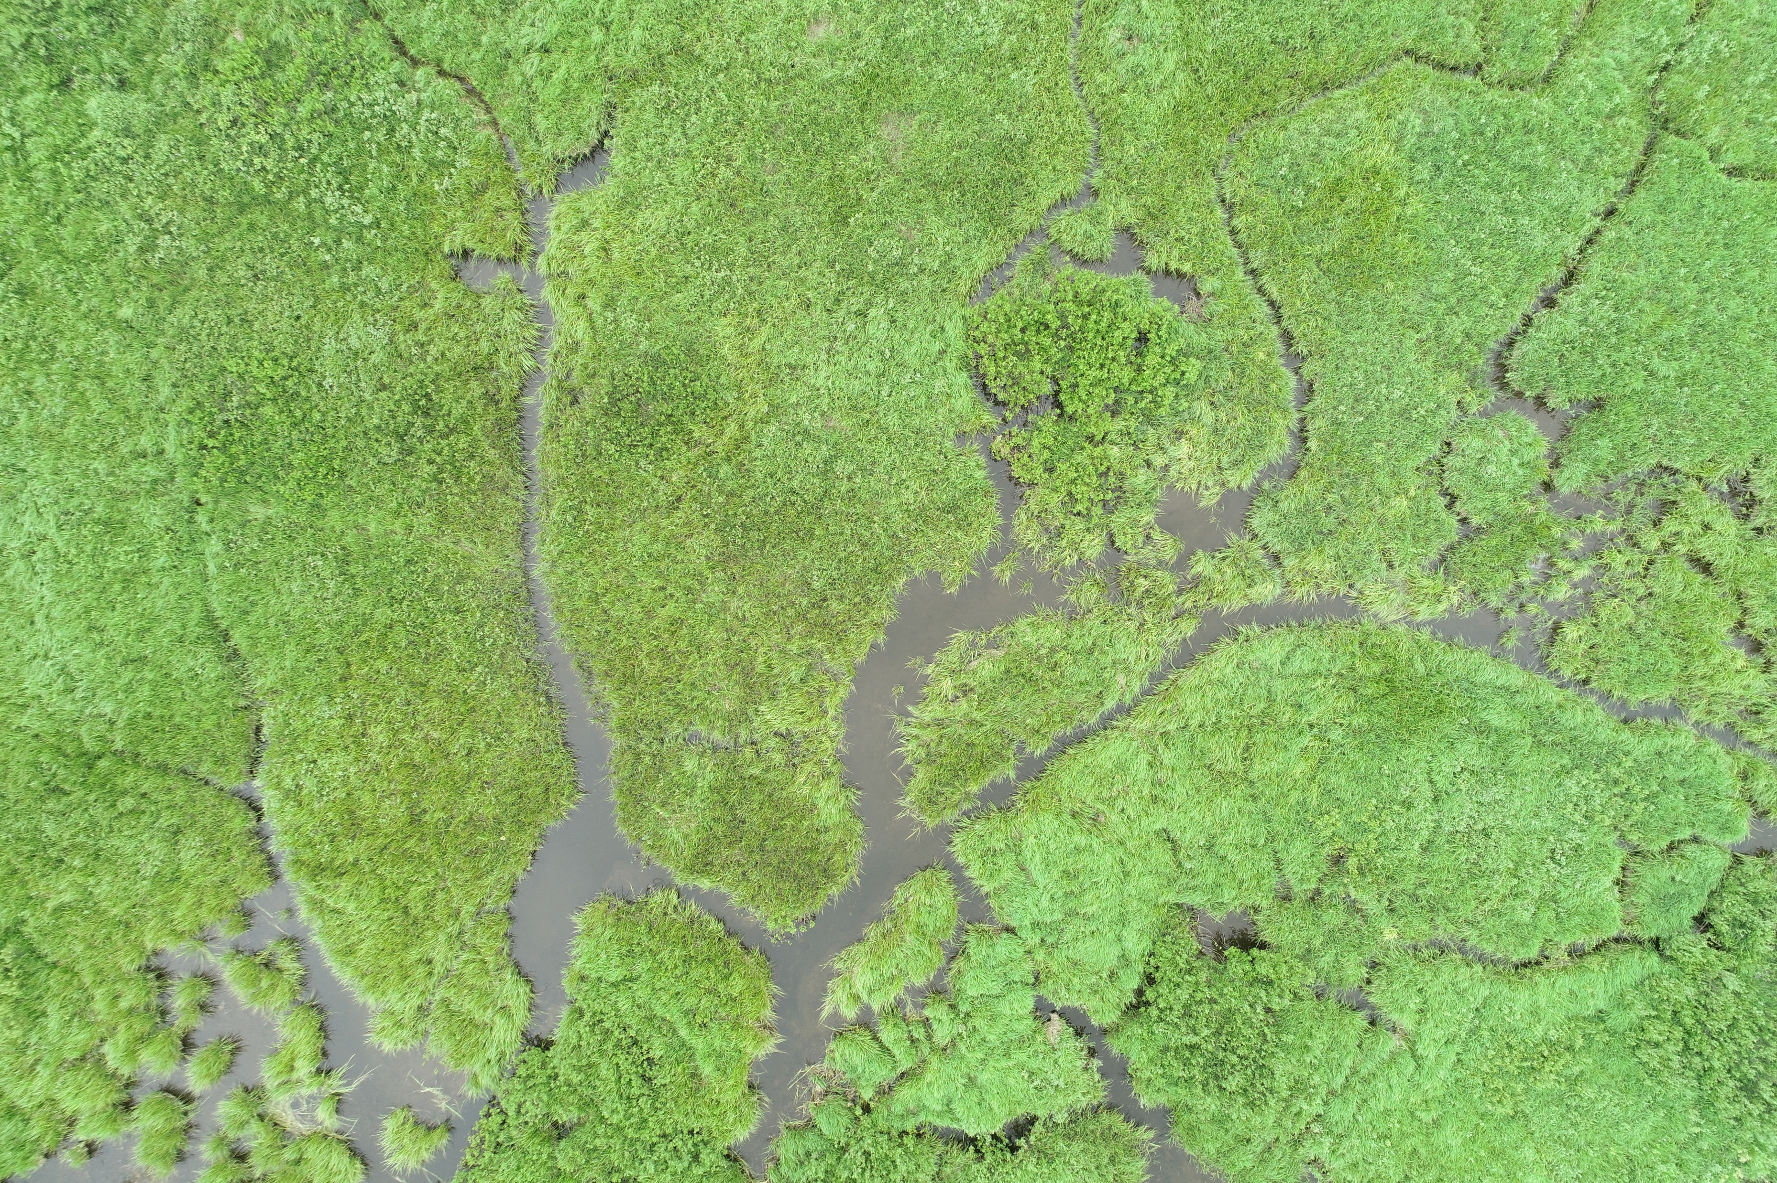
Rehabilitation implications
Prioritize watersheds and reaches
Identify population bottlenecks using species and life stage specific analysis
Identify habitat attribute deficits of specific reaches
Establish target conditions/habitat characteristic benchmarks
Notes:
We hope our work can help resource managers and rehabilitation planners in a variety of ways from strategic planning for reach and watershed rehabilitation, identifying species or life-stage specific bottlenecks, and identifying habitat attribute deficits of specific reaches. By focusing in on the top 10% of the capacity distribution, we have a better understanding of habitat characteristics associated with higher capacity estimates.

Slide 17
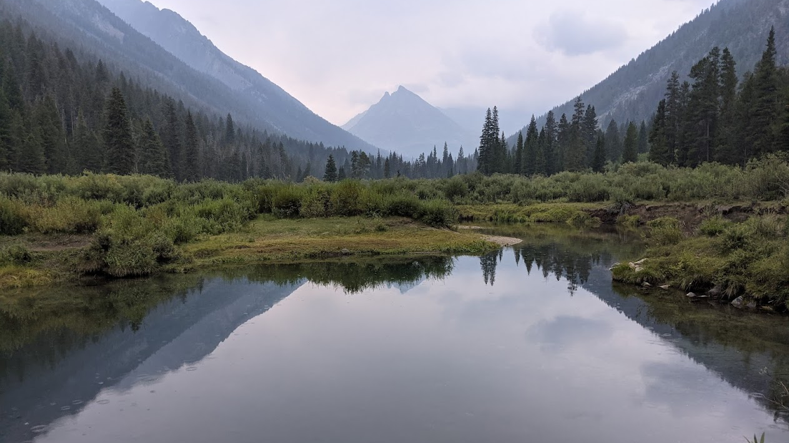
Questions?
tulley.mackey@mthoodenvironmental.com
www.mthoodenvironmental.com
O: 503-668-0033
C: 208-315-3059

Slide 18
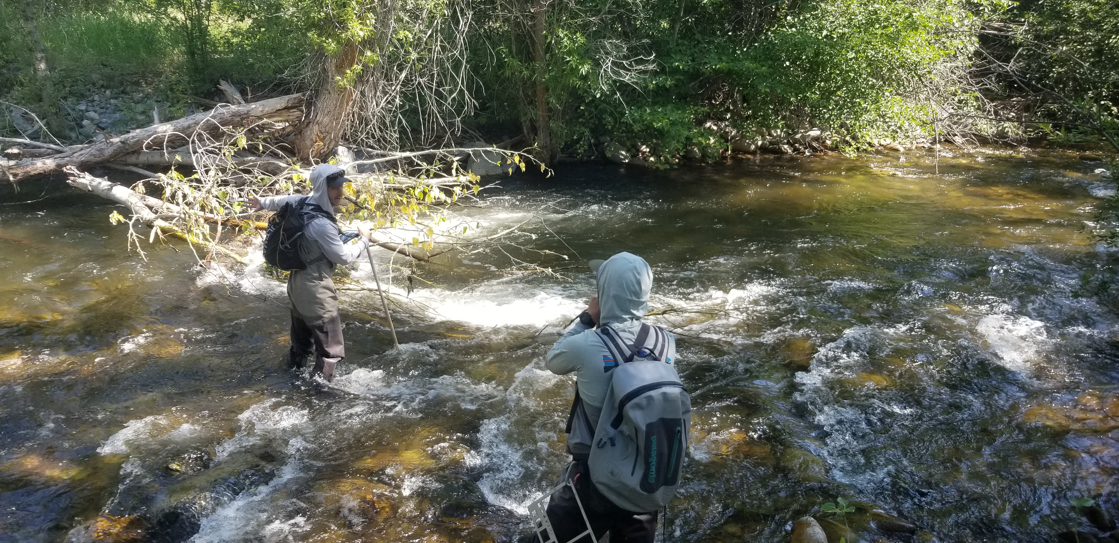
DASH Survey Outline
Channel unit delineation
Thalweg exit and max depth
Substrate estimate/pebble count
Fish cover estimate
LWD, undercut measurement
Discharge
Orthomosaic imagery
1-1.5 km/day depending on habitat complexity, terrain and number of surveyors
ArcGIS online apps: Field Maps, Survey123
Phantom 4 pro UAS
Notes:
DASH Survey outline

Slide 19
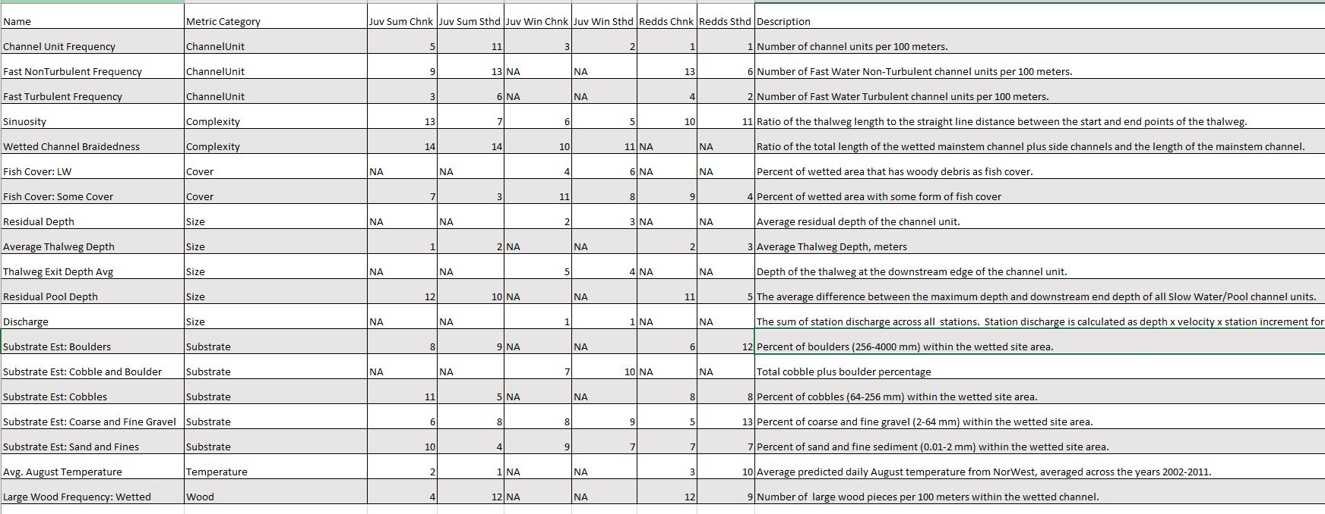
Quantile Random Forest Model Covariates
Notes:
QRF – Habitat covariates and their descriptions for three life stage QRF capacity models. Numbers indicate where each metric ranked in relative importance for each species. NAs indicate the metric was not used for a given model.

Slide 20
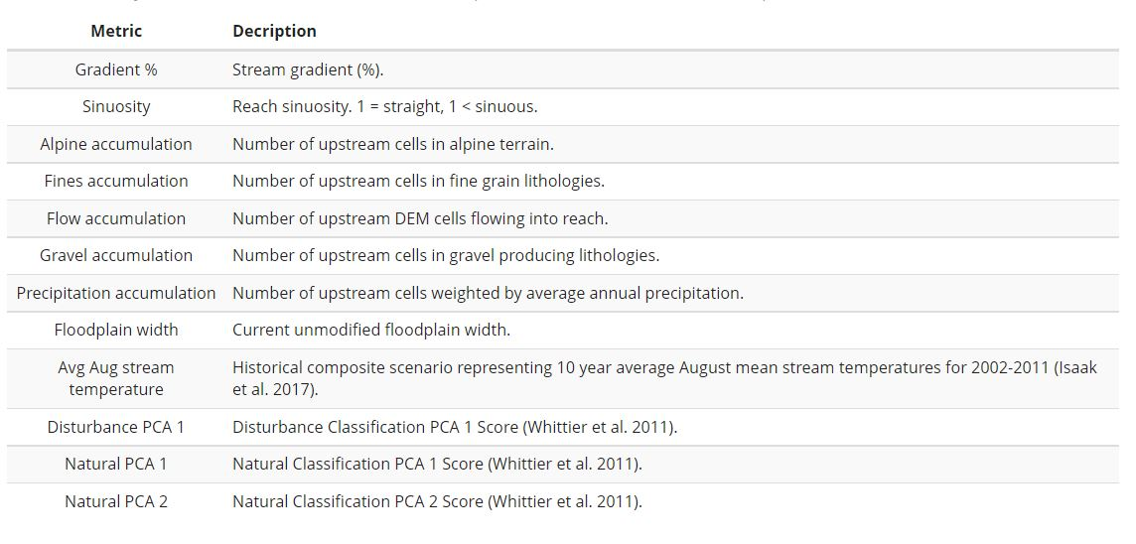
Random Forest Extrapolation Model Globally available attributes (GAAs)
Morgan Bonds 200m CRB linear network
GAA’s and habitat capacity estimates
Notes:
RF Extrapolation – Globally available attributes (GAAs) and their descriptions used in the random forest extrapolation model.

